Slide 1

Web Mining: An Introduction
152.152.98.11 - - [16/Nov/2005:16:32:50 -0500] "GET /jobs/ HTTP/1.1" 200 15140 "http://www.google.com/search?q=salary+for+data+mining&hl=en&lr=&start=10&sa=N" "Mozilla/4.0 (compatible; MSIE 6.0; Windows NT 5.1; SV1; .NET CLR 1.1.4322)“
252.113.176.247 - - [16/Feb/2006:00:06:00 -0500] "GET / HTTP/1.1" 200 12453 "http://www.yisou.com/search?p=data+mining&source=toolbar_yassist_button&pid=400740_1006" "Mozilla/4.0 (compatible; MSIE 6.0; Windows NT 5.1; SV1; MyIE2)"
252.113.176.247 - - [16/Feb/2006:00:06:00 -0500] "GET /kdr.css HTTP/1.1" 200 145 "http://www.kdnuggets.com/" "Mozilla/4.0 (compatible; MSIE 6.0; Windows NT 5.1; SV1; MyIE2)"
252.113.176.247 - - [16/Feb/2006:00:06:00 -0500] "GET /images/KDnuggets_logo.gif HTTP/1.1" 200 784 "http://www.kdnuggets.com/" "Mozilla/4.0 (compatible; MSIE 6.0; Windows NT 5.1; SV1; MyIE2)"
Gregory Piatetsky-Shapiro
KDnuggets
152.152.98.11 - - [16/Nov/2005:16:32:50 -0500] "GET /jobs/ HTTP/1.1" 200 15140 "http://www.google.com/search?q=salary+for+data+mining&hl=en&lr=&start=10&sa=N" "Mozilla/4.0 (compatible; MSIE 6.0; Windows NT 5.1; SV1; .NET CLR 1.1.4322)“
252.113.176.247 - - [16/Feb/2006:00:06:00 -0500] "GET / HTTP/1.1" 200 12453 "http://www.yisou.com/search?p=data+mining&source=toolbar_yassist_button&pid=400740_1006" "Mozilla/4.0 (compatible; MSIE 6.0; Windows NT 5.1; SV1; MyIE2)"
252.113.176.247 - - [16/Feb/2006:00:06:00 -0500] "GET /kdr.css HTTP/1.1" 200 145 "http://www.kdnuggets.com/" "Mozilla/4.0 (compatible; MSIE 6.0; Windows NT 5.1; SV1; MyIE2)"
252.113.176.247 - - [16/Feb/2006:00:06:00 -0500] "GET /images/KDnuggets_logo.gif HTTP/1.1" 200 784 "http://www.kdnuggets.com/" "Mozilla/4.0 (compatible; MSIE 6.0; Windows NT 5.1; SV1; MyIE2)"
An extract from KDnuggets web log

Slide 2

World Wide Web – a brief history
Who invented the wheel is unknown
Who invented the World-Wide Web ?
  (Sir) Tim Berners-Lee
  in 1989, while working at CERN, invented the World Wide Web, including URL scheme, HTML, and in 1990 wrote the first server and the first browser
  Mosaic browser developed by Marc Andreessen and Eric Bina at NCSA (National Center for Supercomputing Applications) in 1993; helped rapid web spread
  Mosaic was basis for Netscape …

Slide 3
What is Web Mining?
Discovering interesting and useful information from Web content and usage
Examples:
Web search, e.g. Google, Yahoo, MSN, Ask, …
Specialized search: e.g. Froogle (comparison shopping), job ads (Flipdog)
eCommerce :
  Recommendations: e.g. Netflix, Amazon
  improving conversion rate: next best product to offer
Advertising, e.g. Google Adsense
Fraud detection: click fraud detection, …
Improving Web site design and performance

Slide 4
How does it differ from “classical” Data Mining?
The web is not a relation
  Textual information and linkage structure
Usage data is huge and growing rapidly
  Google’s usage logs are bigger than their web crawl
  Data generated per day is comparable to largest conventional data warehouses
Ability to react in real-time to usage patterns
  No human in the loop
Reproduced from Ullman & Rajaraman with permission

Slide 5
How big is the Web ?
Number of pages
  Technically, infinite
    Because of dynamically generated content
    Lots of duplication (30-40%)
  Best estimate of “unique” static HTML pages comes from search engine claims
    Google = 8 billion, Yahoo = 20 billion
    Lots of marketing hype
Reproduced from Ullman & Rajaraman with permission

Slide 6
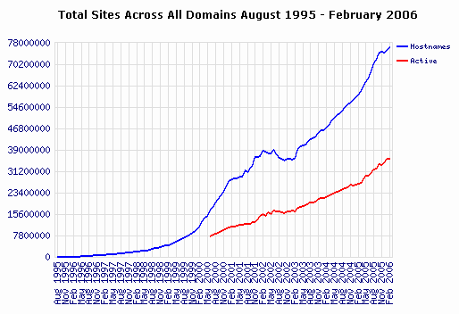
76,184,000 web sites (Feb 2006)
Netcraft survey
http://news.netcraft.com/archives/web_server_survey.html

Slide 7
The web as a graph
Pages = nodes, hyperlinks = edges
  Ignore content
  Directed graph
High linkage
  8-10 links/page on average
  Power-law degree distribution
Reproduced from Ullman & Rajaraman with permission

Slide 8
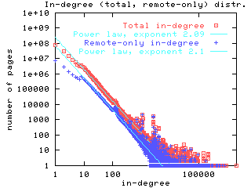
Power-law degree distribution
Source: Broder et al, 2000
Reproduced from Ullman & Rajaraman with permission

Slide 9
Power-laws galore
In-degrees
Out-degrees
Number of pages per site
Number of visitors
Let’s take a closer look at structure
  Broder et al. (2000) studied a crawl of 200M pages and other smaller crawls
    Not a “small world”
Reproduced from Ullman & Rajaraman with permission

Slide 10
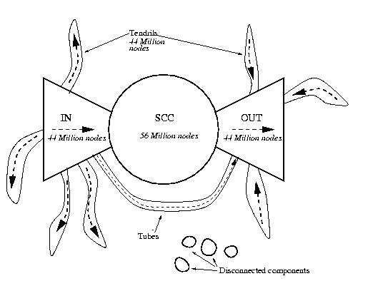
Bow-tie Structure
Source: Broder et al, 2000
Reproduced from Ullman & Rajaraman with permission

Slide 11





Searching the Web
The Web
Content aggregators
Content consumers
Reproduced from Ullman & Rajaraman with permission

Slide 12
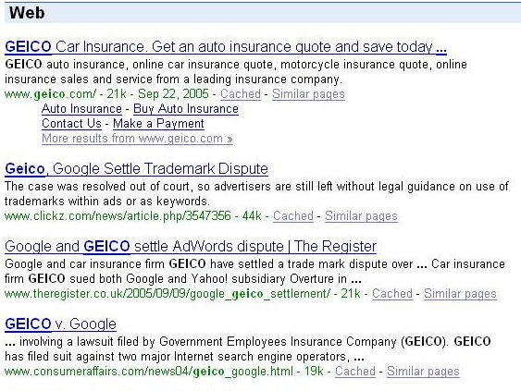
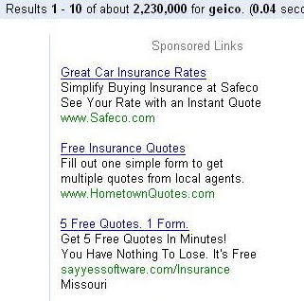
Ads vs. search results
Reproduced from Ullman & Rajaraman with permission

Slide 13
Ads vs. search results
Search advertising is the revenue model
  Multi-billion-dollar industry
  Advertisers pay for clicks on their ads
Interesting problems
  How to pick the top 10 results for a search from 2,230,000 matching pages?
  What ads to show for a search?
  If I’m an advertiser, which search terms should I bid on and how much to bid?
Reproduced from Ullman & Rajaraman with permission

Slide 14
Sidebar: What’s in a name?
Geico sued Google, contending that it owned the trademark “Geico”
  Thus, ads for the keyword geico couldn’t be sold to others
Court Ruling: search engines can sell keywords including trademarks
No court ruling yet: whether the ad itself can use the trademarked word(s)
Reproduced from Ullman & Rajaraman with permission

Slide 15

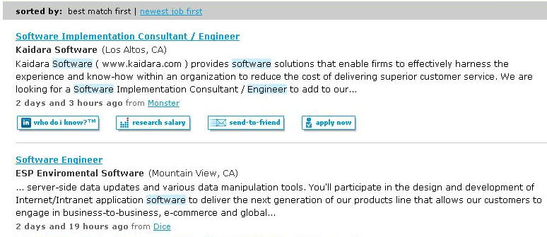
Extracting Structured Data
http://www.simplyhired.com
Reproduced from Ullman & Rajaraman with permission

Slide 16
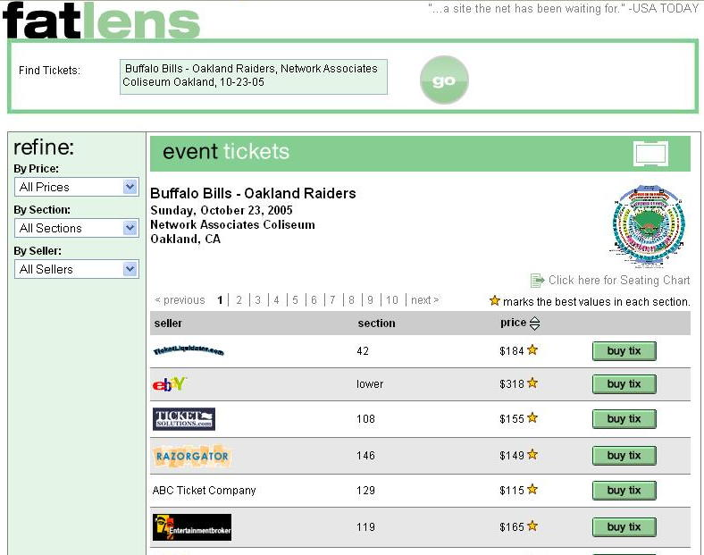
Extracting structured data
http://www.fatlens.com
Reproduced from Ullman & Rajaraman with permission

Slide 17
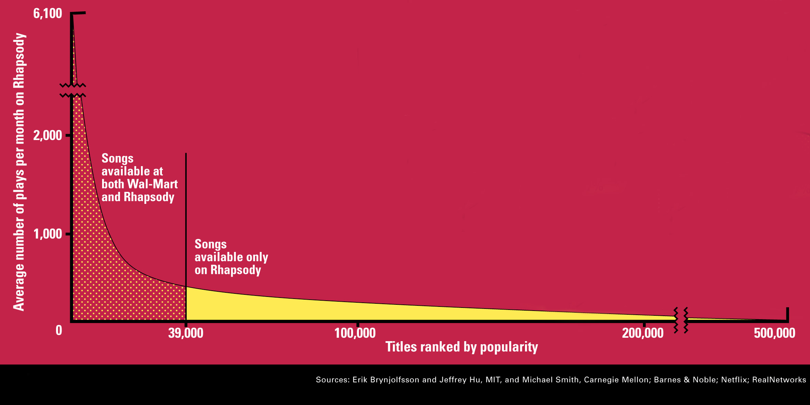
The Long Tail
Source: Chris Anderson (2004)
Reproduced from Ullman & Rajaraman with permission

Slide 18
The Long Tail
Shelf space is a scarce commodity for traditional retailers
  Also: TV networks, movie theaters,…
The web enables near-zero-cost dissemination of information about products
More choices necessitate better filters
  Recommendation engines (e.g., Amazon)
  How Into Thin Air made Touching the Void a bestseller
Reproduced from Ullman & Rajaraman with permission

Slide 19
Web Mining topics
Crawling the web
Web graph analysis
Structured data extraction
Classification and vertical search
Collaborative filtering
Web advertising and optimization
Mining web logs
Systems Issues
Reproduced from Ullman & Rajaraman with permission

Slide 20

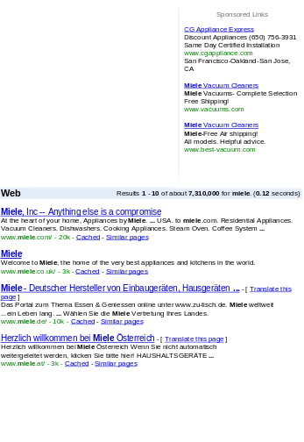

Web search basics
User
Web crawler
Search
Indexer
The Web
Indexes
Ad indexes
Reproduced from Ullman & Rajaraman with permission

Slide 21
Search engine components
Spider (a.k.a. crawler/robot) – builds corpus
  Collects web pages recursively
    For each known URL, fetch the page, parse it, and extract new URLs
    Repeat
  Additional pages from direct submissions & other sources
The indexer – creates inverted indexes
  Various policies wrt which words are indexed, capitalization, support for Unicode, stemming, support for phrases, etc.
Query processor – serves query results
  Front end – query reformulation, word stemming, capitalization, optimization of Booleans, etc.
  Back end – finds matching documents and ranks them
Reproduced from Ullman & Rajaraman with permission

Slide 22
New Web Professions
SEM - Search Engine Marketing
SEO – Search Engine Optimization
Chief Data Officer (at Yahoo)

Slide 23
Web Mining
Web content (and structure) mining
  so far
Web usage mining
  next

Slide 24
Web Usage Mining
Understanding is a pre-requisite to improvement
1 Google, but 70,000,000+ web sites
Applications:
Simple and Basic:
  Monitor performance, bandwidth usage
  Catch errors (404 errors- pages not found)
  Improve web site design
    (shortcuts for frequent paths, remove links not used, etc)
  …
Advanced and Business Critical :
  eCommerce: improve conversion, sales, profit
  Fraud detection: click stream fraud, …
  …

